Slide 1

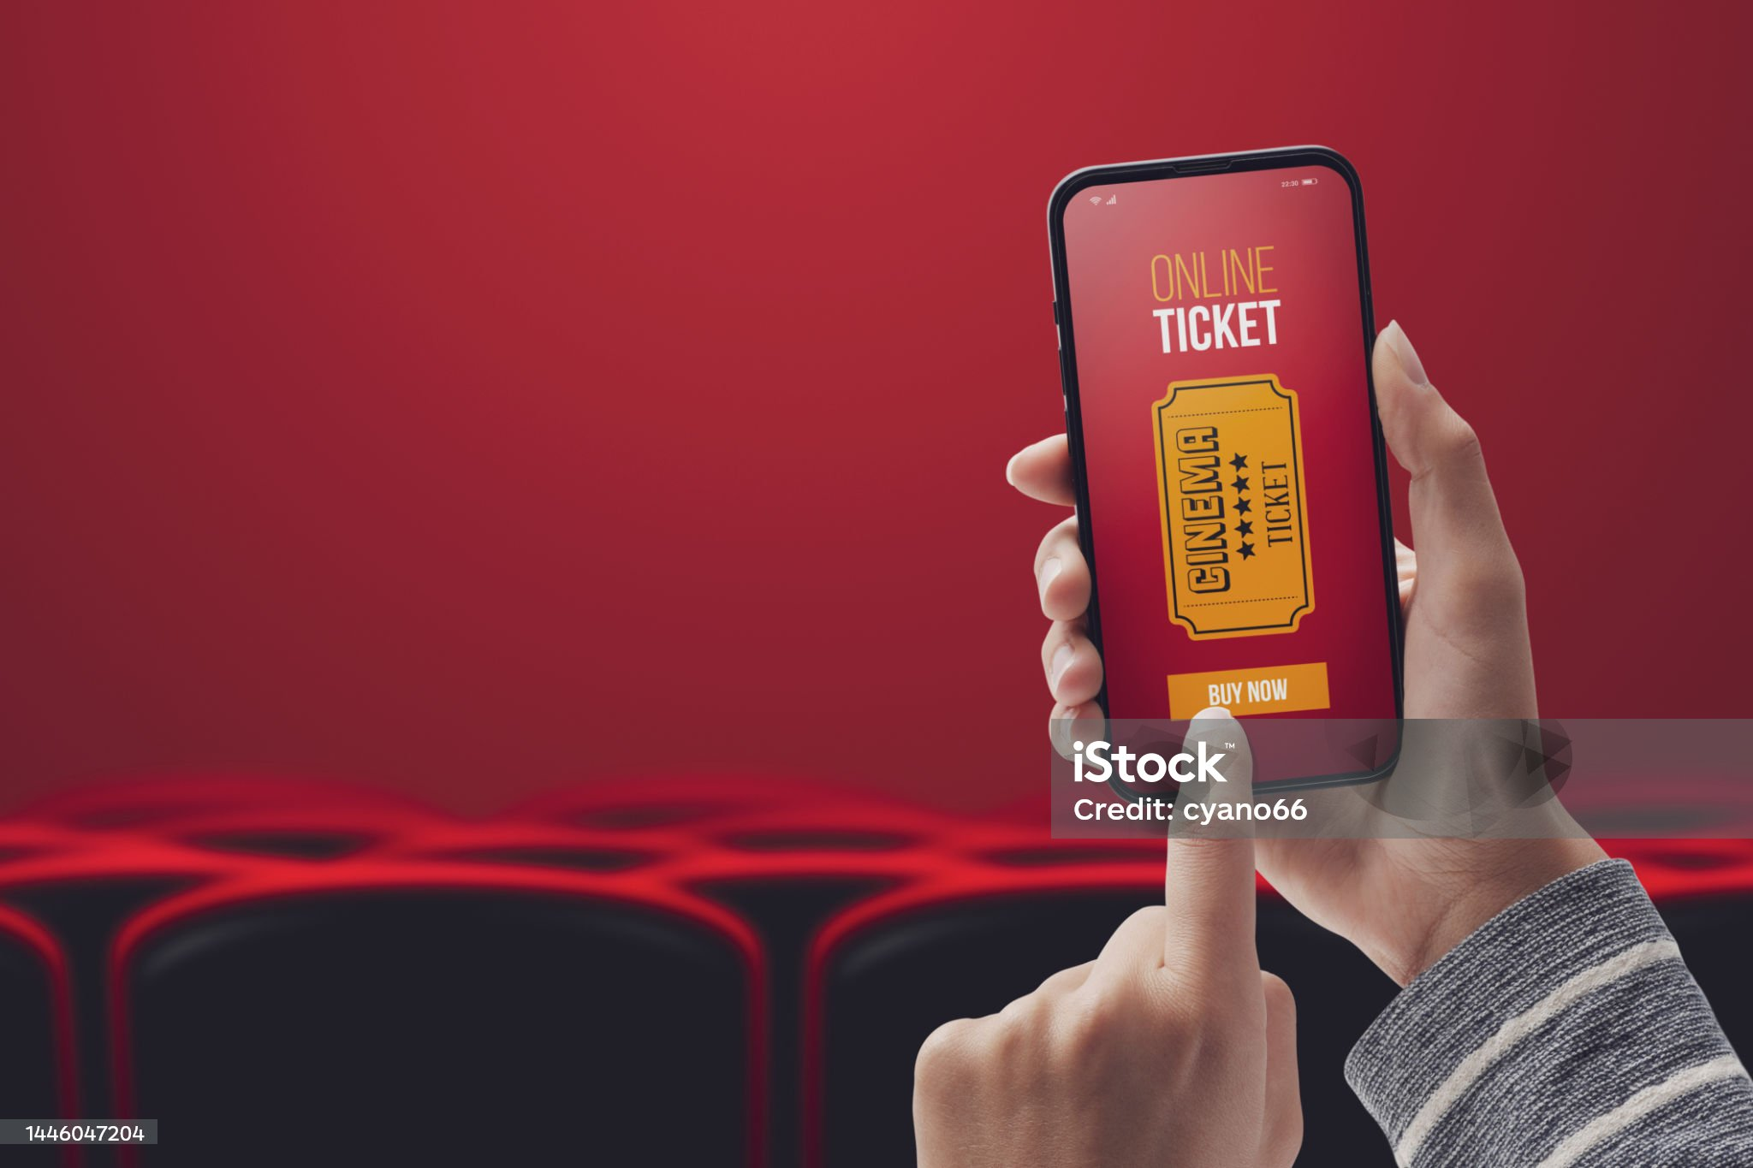
Online Movie Ticket Booking
Presentation by:
Divyaprada G

Slide 2

AGENDA
Use Case
o1. Project Overview o7. Update/Edit Movie
o2. Use Case Diagram o8. Movie Booking
o3. About the Use Case o9. Select seats/Assign seat
o4. Flow Chart’s 1o. Payment and Cancel Booking
o5. Login for Customer’s 11. Logout from Application
&Theatre Owner’s
o6. View Movie Details
07. Add Movie and Show Timings

Slide 3
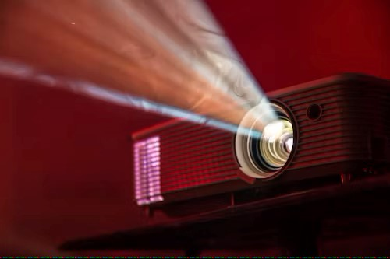
Project Overview
The purpose of the online movie ticket booking system is to automate the manual system of buying tickets from physical counters. The required software and hardware specifications are readily available and very efficient to work with.
The objectives are :-
An online system allows customers to access services from the comfort of their homes. As long as a user has access to a phone or computer, they can get easy access to the services available.
Online platforms don't need a break or the night off. They can run constantly, giving every customer the benefit of accessing information at any time of the day.
When a business has an online service platform, there is no limit to the number of people it can reach. It is not limited by the time either because it operates 24/7. This means that promotions and ads can run throughout and this could potentially boost sales.

Slide 4
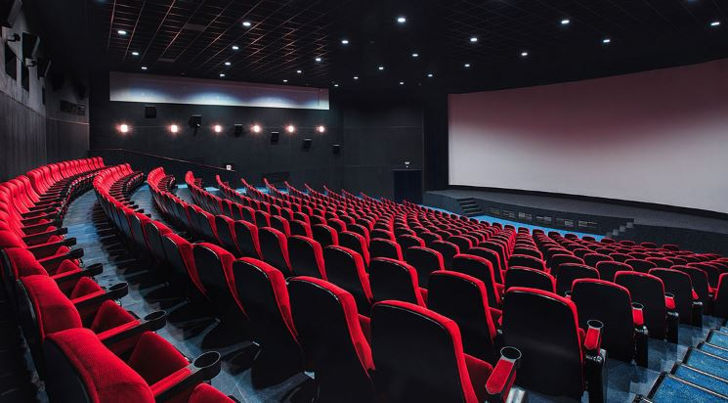
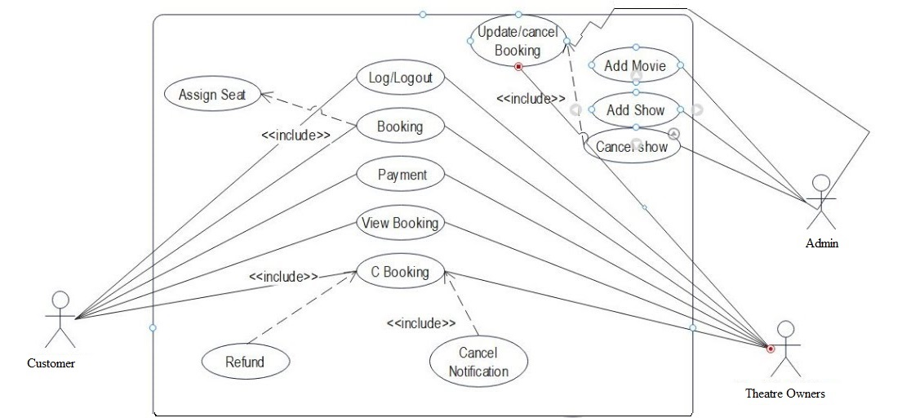
Use Case

Slide 5

About the Use Case
A Movie Ticket Booking System is a software application designed to allow users to book movie tickets online. The platform offers a range of features and functionalities to help users search for movies, view movie details, select seats, pay for tickets, and cancel bookings.
The use case diagram for the platform helps to identify the key interactions between the user and the system.

Slide 6
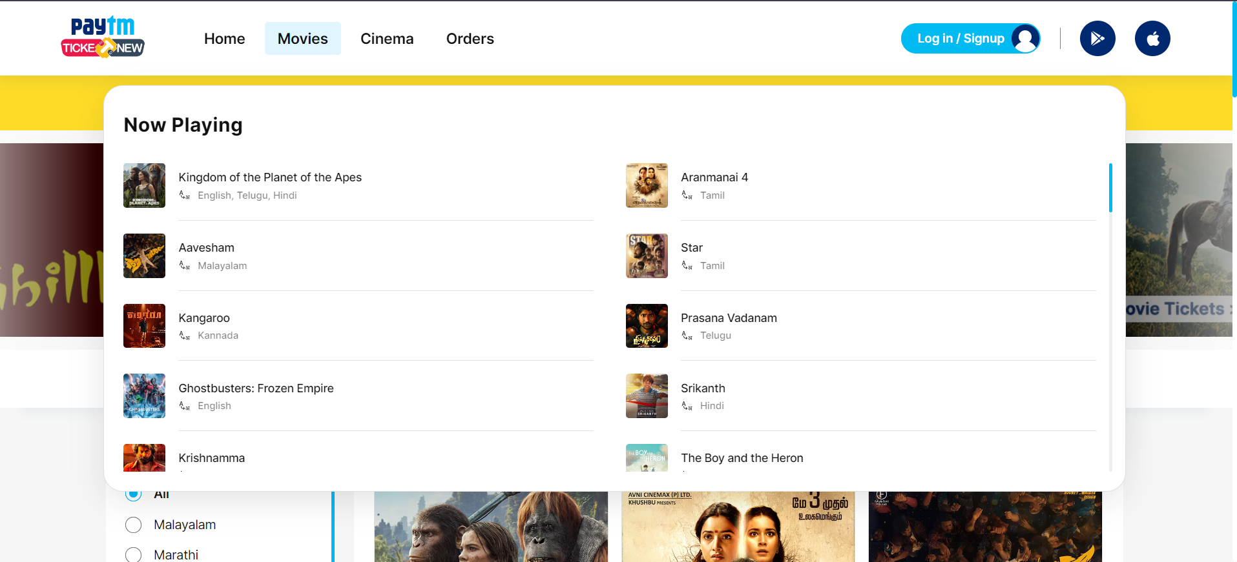
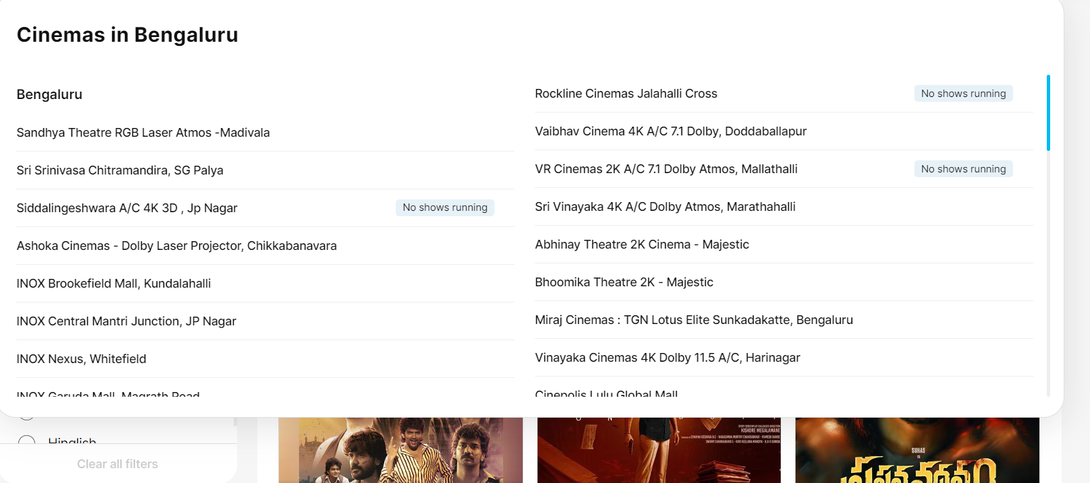

Slide 7
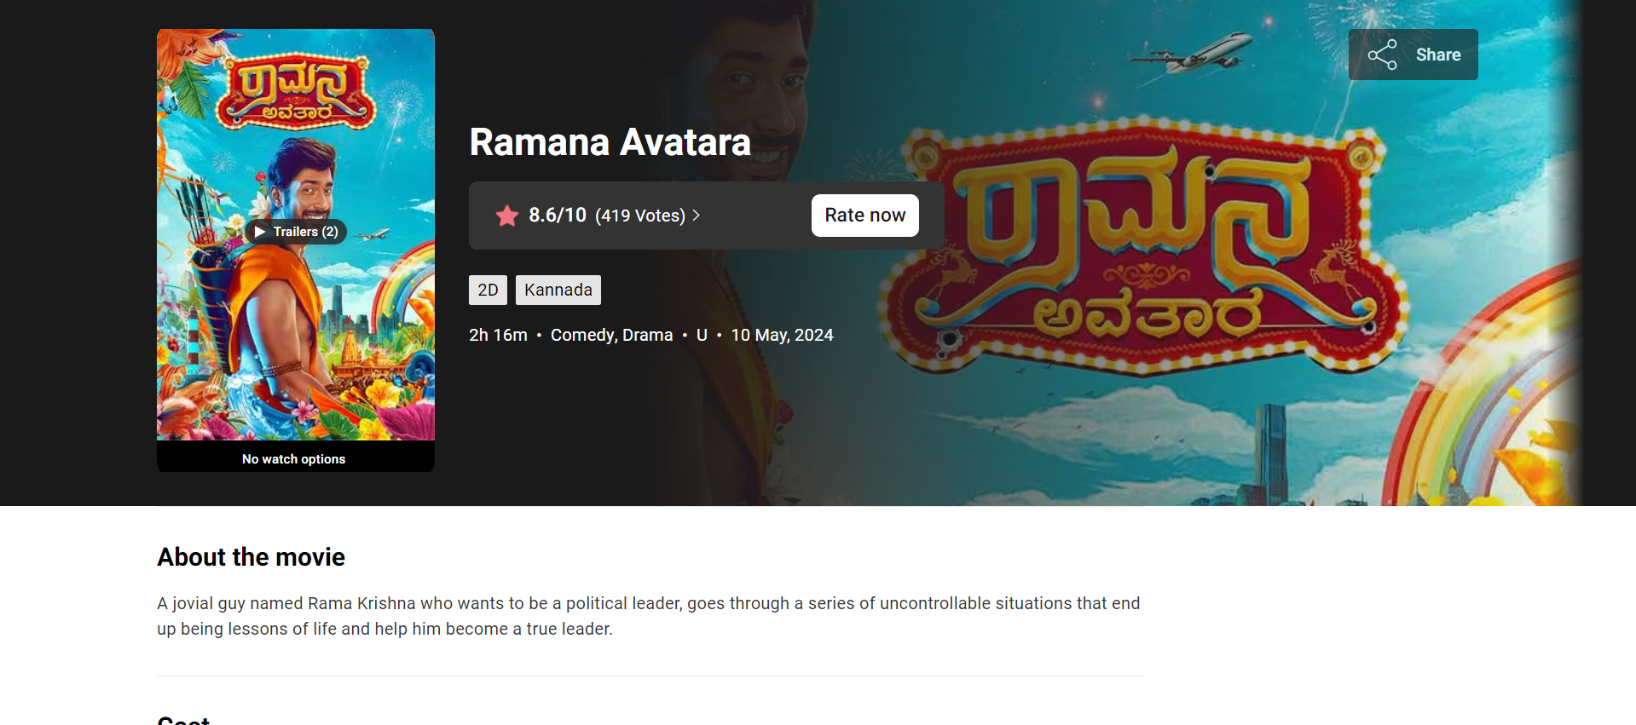
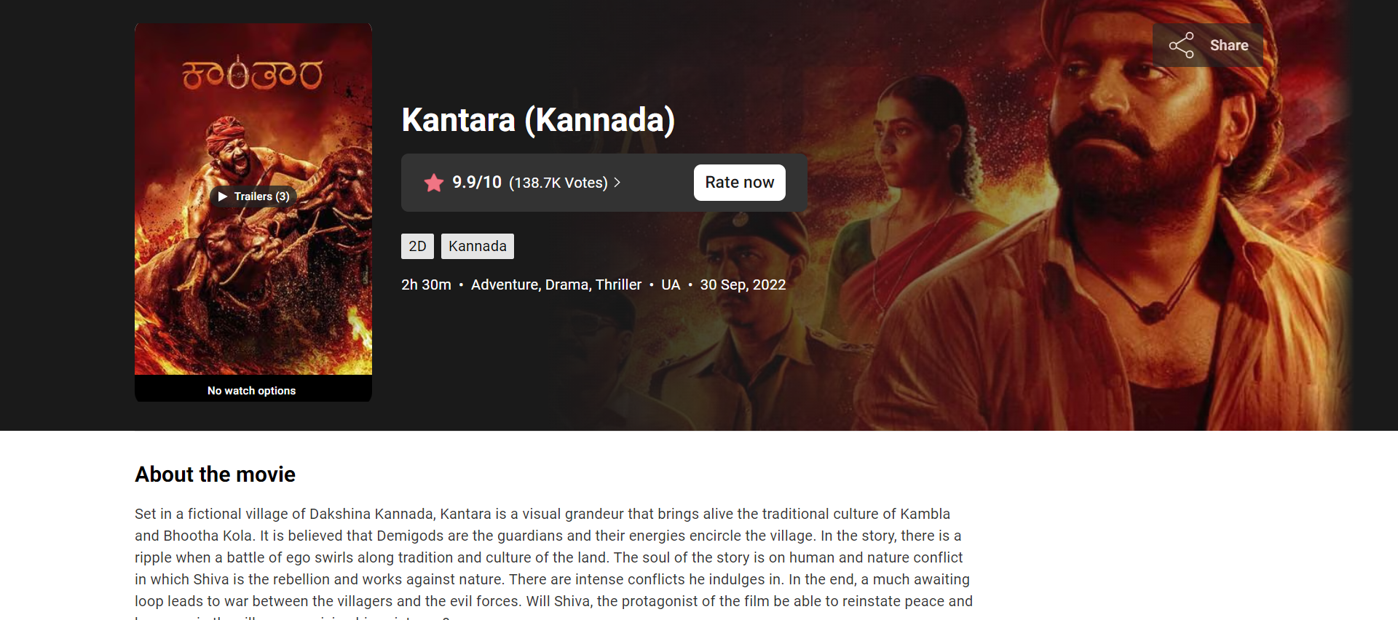

Slide 8

Flow Chart for Admin
START
Login
Success
If the Login
Is ?
UnSuccess
Success
Admin can view customer’s and theatre owner’s
Admin can redirect to the login page
Admin can add movie, add show,
Cancel show’s
Logout
STOP

Slide 9
START
Flow Chart for Customer
Register
Login
If the Login
Is ?
UnSuccessful
Success
Customer can redirect to the login page
Customer can Booking the Movie ticket
Payment method

Slide 10
If the Payment
Is ?
UnSuccessful
Successful
Check the payment details
Received the ticket booking verification
Mail / SMS
Logout
STOP

Slide 11
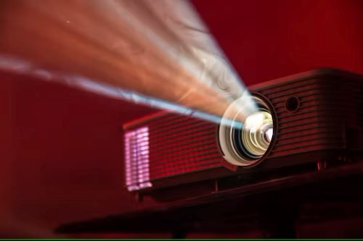
Log-in for Customer’s & Theatre Owner’s
Login is another use case that enables users to login the movie ticket booking application through their detailed information about a specific detail’s, such as the UserId,Name,Password,Email. This use case is essential in helping users can login to the application for booking a movie ticket for the good experience.

Slide 12

View Movie Details
View Movie Details is another use case that enables users to view detailed information about a specific movie, such as the plot, cast, director, and ratings. This use case is essential in helping users make informed decisions about which movie to watch and ensuring that they have a good experience.

Slide 13
Add Movie and Show Timings
The TheatreOwner adds details of a new film. Film details include Title, Age Rating, Duration, and short trailer description.
The TheatreOwner adds details of a new showing of a film. Showing details include the date and time of the showing. (Showing details must also be able to record the number of tickets sold against the showing at any time).

Slide 14

Update/Edit MOvie
They control the platform. They make sure everything is updated and running smoothly.
The Admin can Edit or modify movie details such as title, description, genre, duration, and rating. The Admin can also set the show times for each movie and manage the available seats for each show.
Admin can manage the show venues, such as the listed cinema theatres and filter them by the venue, location, date, show-time, price range, etc.
The admin may prefer to add a cinema or remove or edit besides adding new venues.

Slide 15
Movie Booking
Movie booking is a use case that enables users to book for movies based on specific criteria such as location, genre, language, and show timings.
Once a user selects a movie, they can view movie details and show timings for that movie.
Customer can read the movie details and Book the movie ticket.
Finally received the Ticket booking verification mail/SMS.

Slide 16

Select Seats/Assign Seat
Select Seats is a key use case that enables users to select their preferred seats in the movie theatre. The system should provide users with a graphical representation of the theatre layout and available seats. Users can select seats based on their preference, such as location, proximity to the screen, and availability.

Slide 17

Payment and Cancel Booking
Pay for Tickets and Cancel Booking are the final use cases of the Movie Ticket Booking System.
Pay for Tickets allows users to make payment for the tickets using various payment methods such as credit/debit cards, mobile wallets, or internet banking.
Cancel Booking allows users to cancel their booking if necessary and receive a refund if applicable. These use cases are essential in ensuring that users can complete the booking process smoothly and without any issues.

Slide 18
LogOut From Application
Logging out of a application is very important because there are risk with not logging out. One of the factor is using a public computer, this is where anyone can use a public computer when someone is still logged in to an account and can mess with that person's work.
it's easy for anyone to see confidential information.
Logging out is particularly important when you are not using your own computer. It reduces the chance of someone else accessing your information.

Slide 19
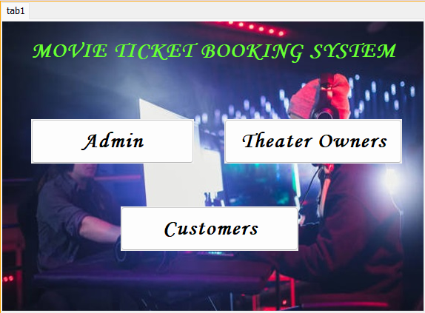
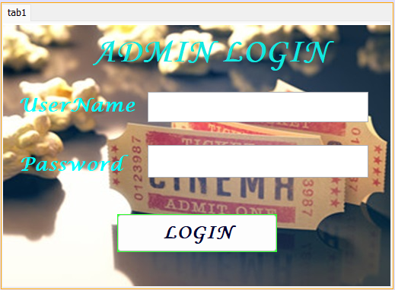
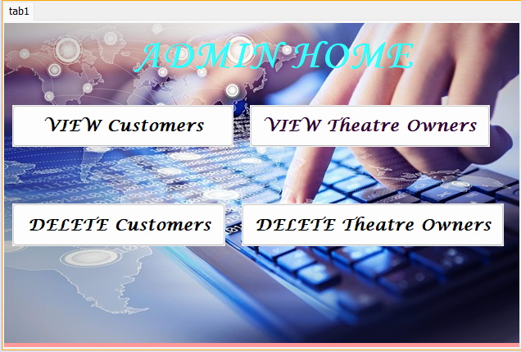
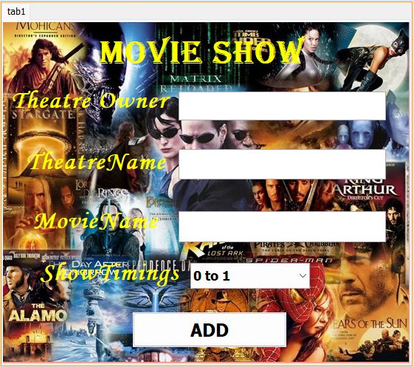
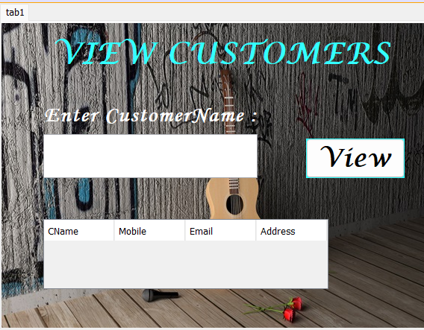
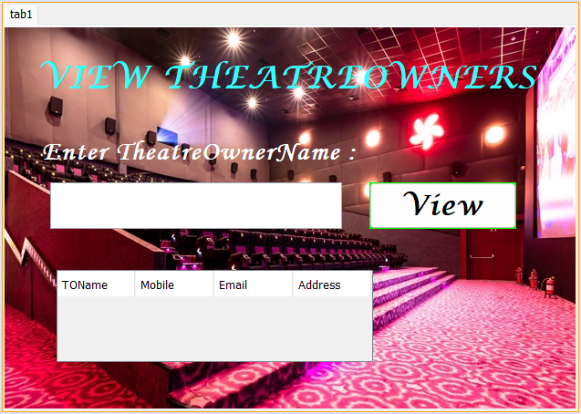
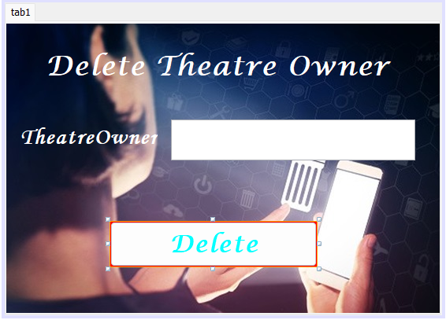
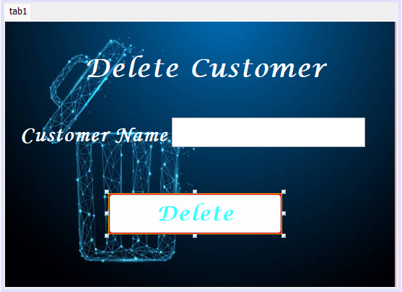
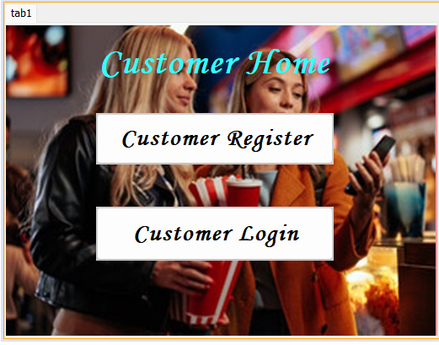
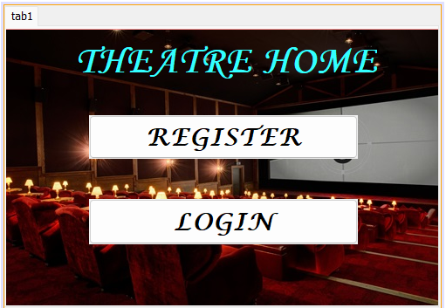
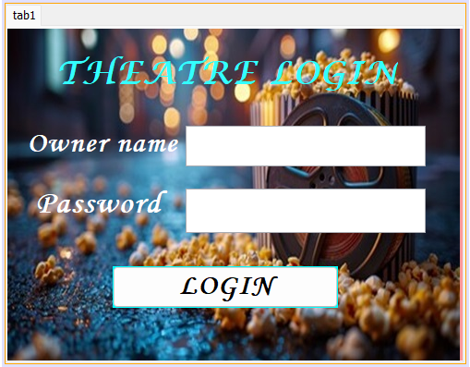
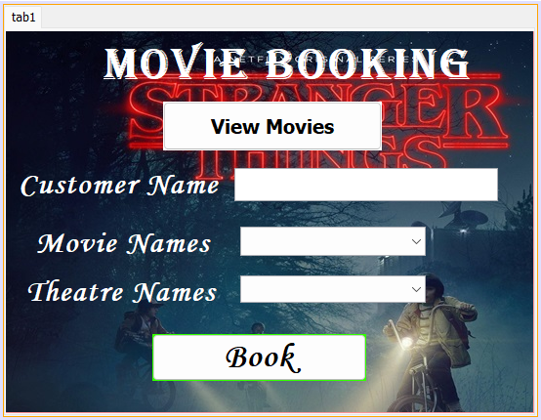

Slide 20
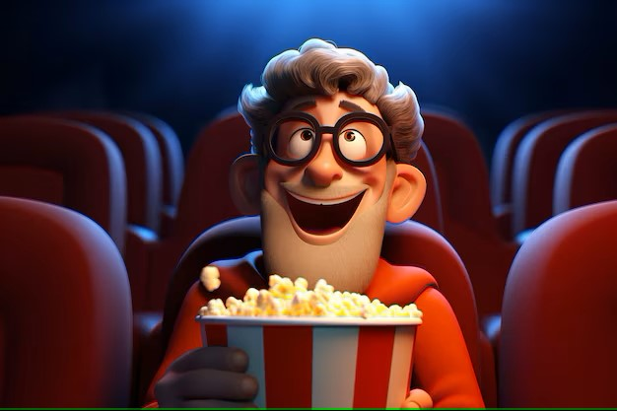

The End
Thank You

